Slide 1

Hackathon App
Group A

Slide 2
The Team
George Brewster (Product Manager)
Travis Rinehart (Scrum Master)
Clinton Andrews
Amy Ly
Jason Hackleman
Joeseph Cutrono – stakeholder Ultimate Software

Slide 3
Hackathon App Overview
Ultimate Software hosts an internal hackathon for their employees and desires an app to help manage several aspects before and during the events. The app would allow Ultimate software employees to operate in two phases. The first phase occurs before an event. The app will provide the means for employees to contribute ideas or form projects out of ideas to include adding team members from Ultimate Software, and categorizing the project. There are static data items that describe the hackathon events, project category types, and other references. The app goes into a second phase when the event is taking place. During this time, the user can track several projects in a schedule, receive push notifications from the schedule, and communicate with team members via a chat (that would also link to Slack). There are administration functions to change project category and manage events that are pushed during a hackathon event along with other housekeeping needs.

Slide 4
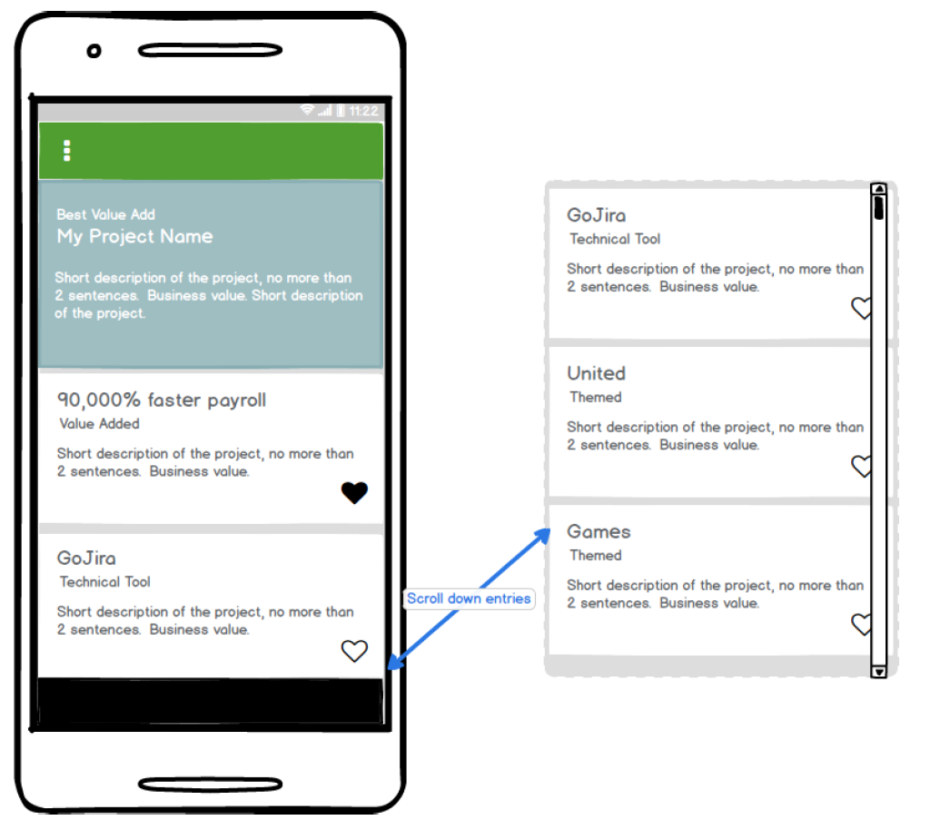
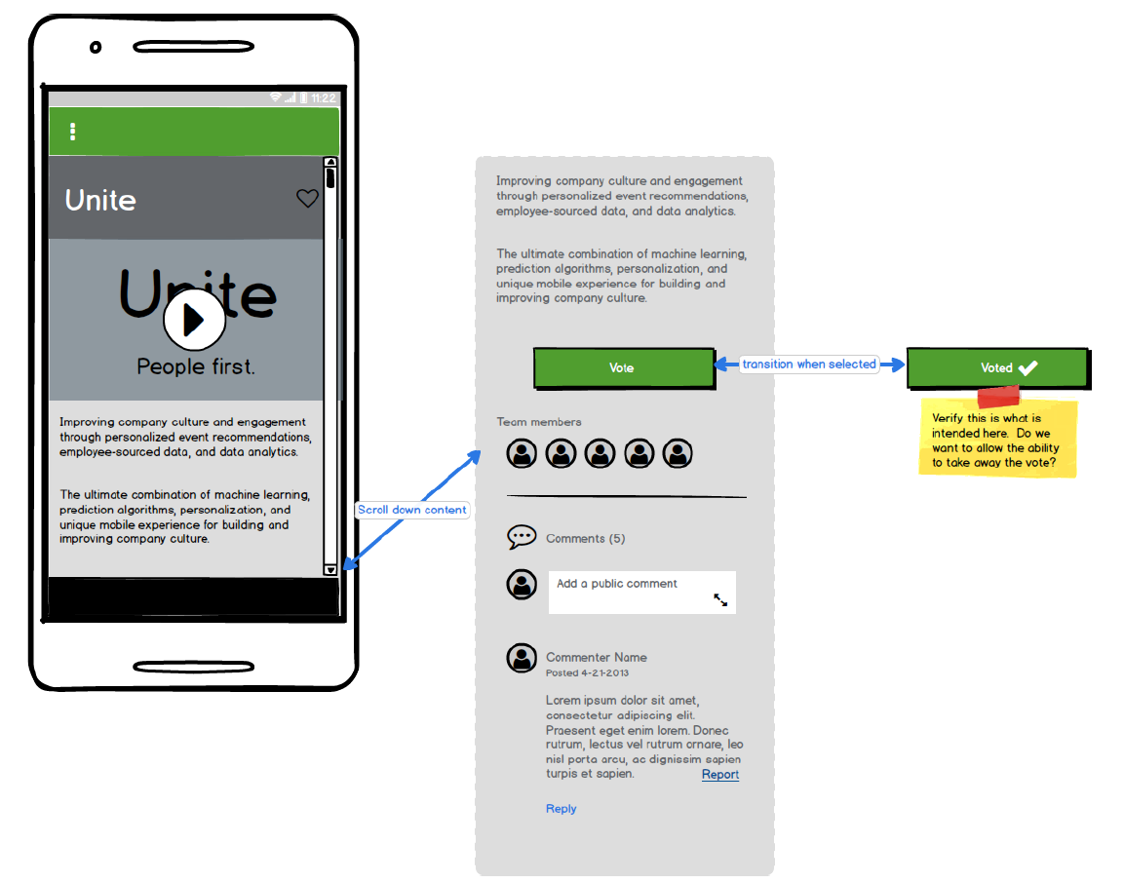
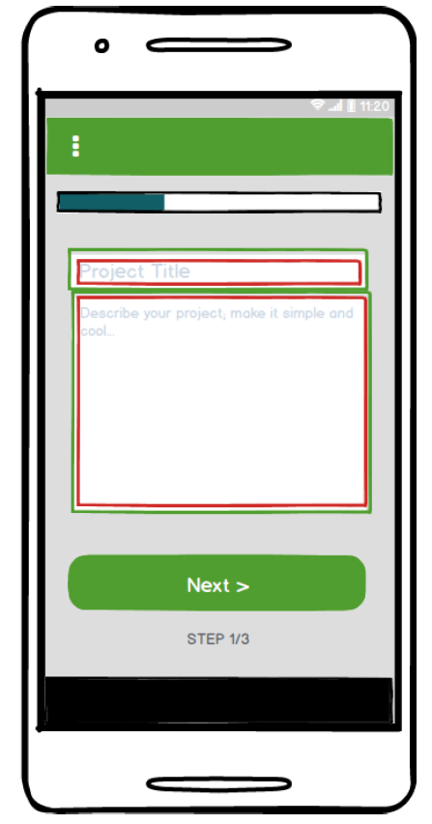
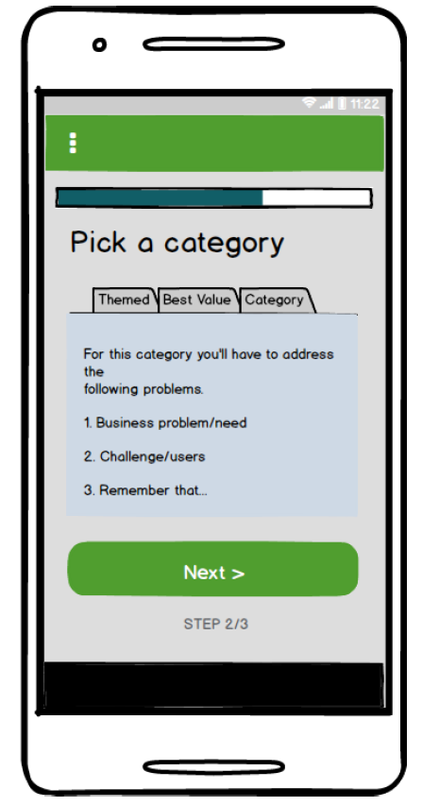
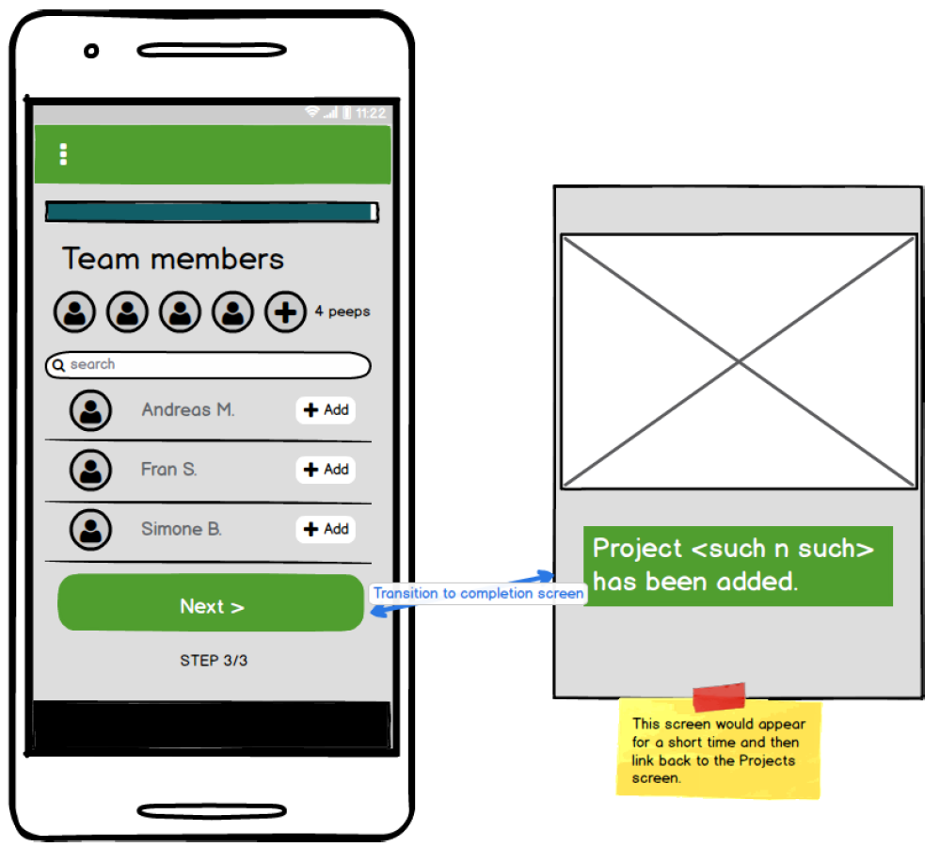
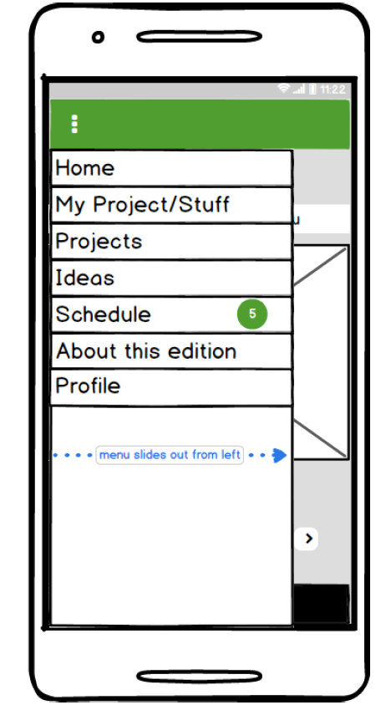
Sprint 1 – Projects & Authentication
The customer asked for the project area of the app to be the first priority for this sprint. The following features were attempted for this sprint:
1. Add a project functionality
2. Basic menu functionality with Home and Projects
3. The main landing page for projects (list)
4. View a selected project (added edit and delete features)
5. Basic back-end development to integrate these features and Heroku integration
6. Beginnings of Authentication

Slide 5
Menu
Creation of a slide-out menu that includes a Home page and Projects page link
Further development is needed for all categories.

Slide 6
Add Project
Add project includes three screens that, when completed, would create a new project object for display in a list of projects
This screen is the first of three where the project title and description are identified. Elements added to ensure the fields are completed with at least some information.

Slide 7
Add Project
Add project includes three screens that, when completed, would create a new project object for display in a list of projects
This screen allows the user to identify a category for the project and give answers to one or two questions that qualify it for the category.
Further development is needed for this screen.

Slide 8
Add Project
Add project includes three screens that, when completed, would create a new project object for display in a list of projects
This screen allows the user to pick available employees to add to the team that would work on the project.
The screen has basic setup available, but is still in need of development.

Slide 9
View Project
View project allows the user to view a selected project from the list of all projects. They will be able to read about the project, view a video that was uploaded for the project, vote on the project and comment.
The basic elements of the project view are there, but development on the voting system, video implementation and comments is still needed.

Slide 10
Project List
The project list displays the added projects in a random order to prevent skewing the audience to any particular project. The view back-end is basically developed with random order working using test data.
Front end work is still needed to complete the layout as well as implementing a “like” system.

Slide 11
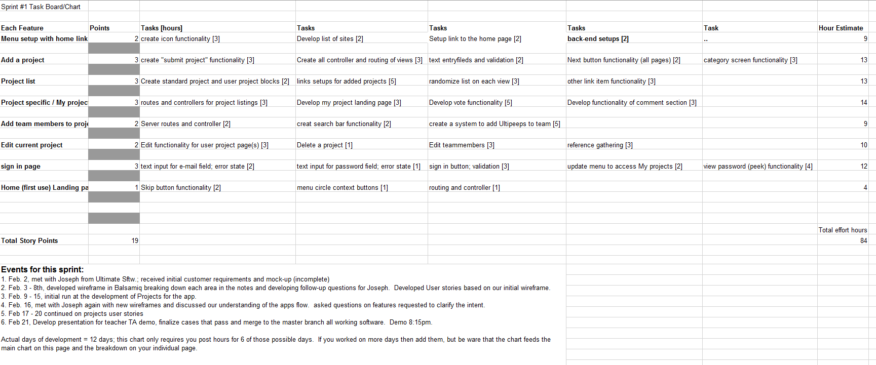
Burn-down Chart Snapshot

Slide 12
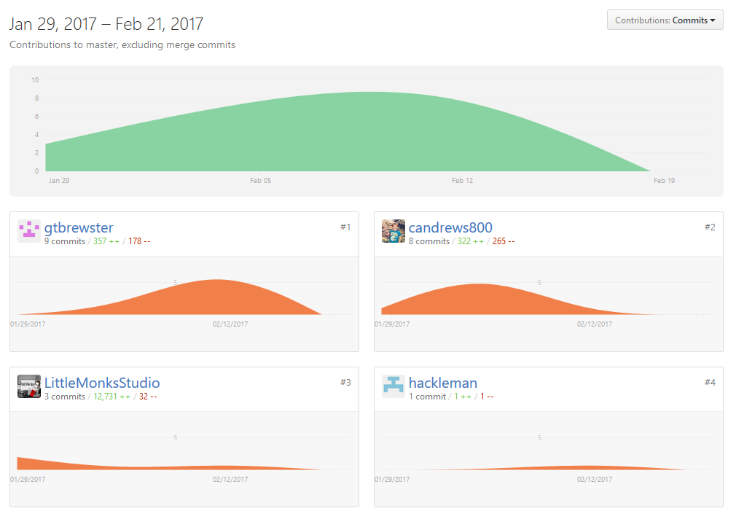
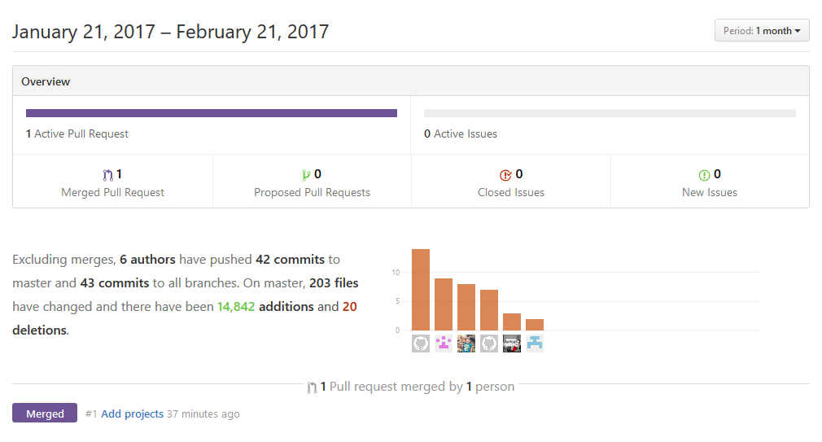
GitHub Charts & Burndown Chart

Slide 13
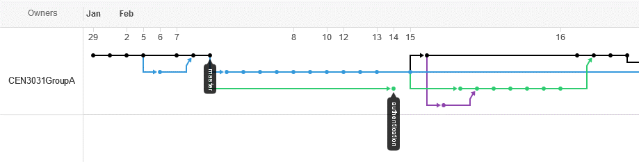
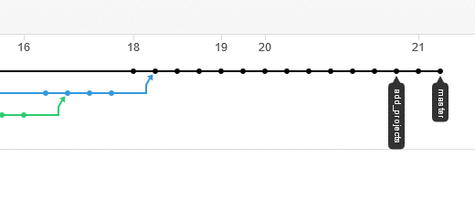
GitHub Activity

Slide 14
Testing and Release
At this point, testing has been done through peer review and running through grunt/Heroku from branches. No implementation of testing via test code has been developed yet.
We are still working on our workflow and will need to make adjustments based on our retrospective coming up on Wednesday.
A released version of the currently working App can be found here:
https://still-eyrie-27550.herokuapp.com/

